Slide 1
Models of Undergraduate Research
Johnson Center
Faculty Development Lunch Discussions
Lance Barton, Bob Cape, & Jeremy Posadas
March 31, 2016

Slide 2
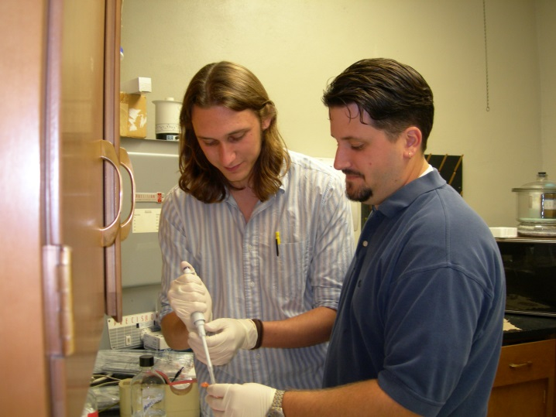
What does Undergraduate Research (U.R.) mean at Austin College?
Our Definition: Any inquiry or investigation conducted by an undergraduate student and mentored by a faculty member that includes original intellectual or creative work that is communicated within a scholarly context.
Learning the Discipline, Practicing the Discipline, and Communicating Publicly
At Austin College: U.R. is pedagogy!
High student impact
Professional skill development
Combination of “soft” and “hard” skills
Resource intensive
Financial
Student time and energy
Faculty time and energy
Strong Benefits
Community Development
Mentor-Mentee Relationship
Faculty Engagement

Slide 3
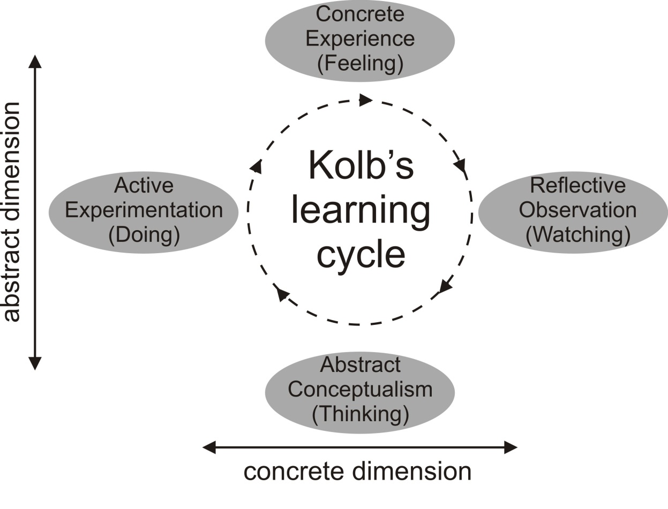
How is knowledge constructed?
New knowledge must connect to, or build upon a framework of existing knowledge
Learning involves building mental models (schema) consisting of new and existing information.
The richer the links between new and existing information, the deeper the knowledge and the more readily it can be retrieved and applied in new situations.
Kolb, D.A., 1984, Experiential learning: Experience as the source of learning and development. Prentice Hall
Notes:
Jeremy to add thoughts

Slide 4
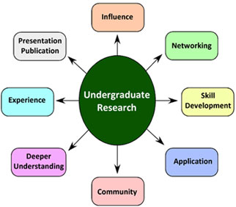
Why Undergraduate Research?
Undergraduate Research promotes:
deeper understanding
an active role in inquiry,
improved speaking and writing ability,
skills to think “outside the box.”
lasting associations with research mentors
http://www.lib.usf.edu/
Undergraduate Research creates a community of critical readers and informed conversationalists
(Seymour, et al., 2004; Hensel & Paul, 2012)

Slide 5
A Developmental Model
Undergraduate Research is most effective when following an IDM model – introduction, developmental, & mastery - for skill development and practice.
Freshman Sophomore Junior Senior
Novice Apprentice Journeyman Master
Early introduction into curriculum and deliberate developmental assignments build skills and help mitigate student dread of research while truly educating undergrads in research proficiency.
(Wiggins & McTighe, 1998)
Notes:
Old model gets them to only sophomore level before thesis = high failure rate
Example rubric skills: problem solving, writing, oral communication, etc…

Slide 6
Traditional Structures of Undergraduate Research:
Curriculum vs Apprentice Model
Apprentice:
The thesis model is resource intensive.
Less and less research is truly done in isolation.
Limits to time, energy, numbers, …
Perceived as “elitist” by students not involved.
Curriculum:
Research skills are transferable and applicable to a wide array of careers.
Data show that students who benefit the most from research experiences are not elite.
Challenges to implement and assess
The fears of “sacrificed content”
Limits to what can and cannot be done / accomplished.

Slide 7
What are student learning goals of U.R.?
Students should…
Always question what they know, see, hear
Have authentic moments of discovery
Be open to new evidence and look for ways to incorporate new evidence into their arguments
Understand the context of the question and the underlying assumptions
Work together to learn together – facilitate independent student conversations and learning
Notes:
Let’s take a backwards design approach…

Slide 8
Undergraduate Research in Humanities (Classics)
Challenges & Assumptions
Developmental Model
Intro Courses & Existing Practices
Community Building
Creating Conversations
Intermediate Courses
Affirming Community
Deepening Conversations
Advanced Courses
Add Research Skills
Notes:
Bob

Slide 9
Undergraduate Research in Humanities
What defines the research process in the humanities?
How do we intentionally and thoughtfully provide opportunities to model this process?
How do we provide opportunities for students to have authentic moments of discovery?
Notes:
Jeremy

Slide 10
Undergraduate Research in the Sciences
Introductory courses
Getting students to think about new evidence and look for ways to incorporate new evidence into their arguments
Intermediate/Advanced Courses
Creating opportunity
Research team model
Facilitating peer learning and conversation
Notes:
Lance

Slide 11
Community Discussion & Examples
Thank you

Slide 12
Bibliography & References
How to Get Started in Arts and Humanities Research with Undergraduates Edited by Iain Crawford, Sara E. Orel, and Jenny Olin Shanahan (Council on Undergraduate Research, 2014)
Creative Inquiry in the Arts & Humanities: Models of Undergraduate Research Edited by Naomi Yavneh Klos, Jenny Olin Shanahan, and Gregory Young (Council on Undergraduate Research, 2011)
Reading, Writing, & Research: Undergraduate Students as Scholars in Literary Studies Edited by Laura L. Behling
(Council on Undergraduate Research, 2009)
Justin E.H. Smith, "A Forgotten Field Could Save the Humanities,” The Chronicle of Higher Education (March 13, 2016; online) http://chronicle.com/article/A-Forgotten-Field-Could-Save/235635?
Multhaup, K., Davoli, C., Wilson, S., Geghman, K., Giles, K., Martin, J., et al. (2010). Three Models for Undergraduate-Faculty Research: Reflections by a Professor and Her Former Students. CUR Quarterly, 31(1), 21-26.
Undergraduate Research Opportunity Program, “Considering Undergraduate Research and Creative Scholarship” (University of Oregon, online)
http://urop.uoregon.edu/for-faculty/considering-undergraduate-research-and-creative-scholarship/

