Slide 1
Diversity in Models for Undergraduate Research with a special focus on Arts & Humanities

Slide 2
Presentation at the CUR Undergraduate Program Director’s Meeting
June 2017, NAU
Original presentation can be found at:
https://tinyurl.com/y8cymq6k
Jenny Shanahan (English)
Bridgewater State Univ (MA)
jshanahan@bridgew.edu
Greg Young (Music)
Montana State University
gyoung@montana.edu

Slide 3
Undergraduate Research Scholarship Creative Activities (URSCA) is a high-impact practice for students across disciplines, GPAs, demographics— especially underrepresented students and those at risk of leaving college.
We cannot afford to leave out students from non-STEM programs.

Slide 4
But… What is Research?
Is it defined by the outcomes?
Is it a process?
What is the role of the faculty?
What can it mean?
What is valued in research?

Slide 5
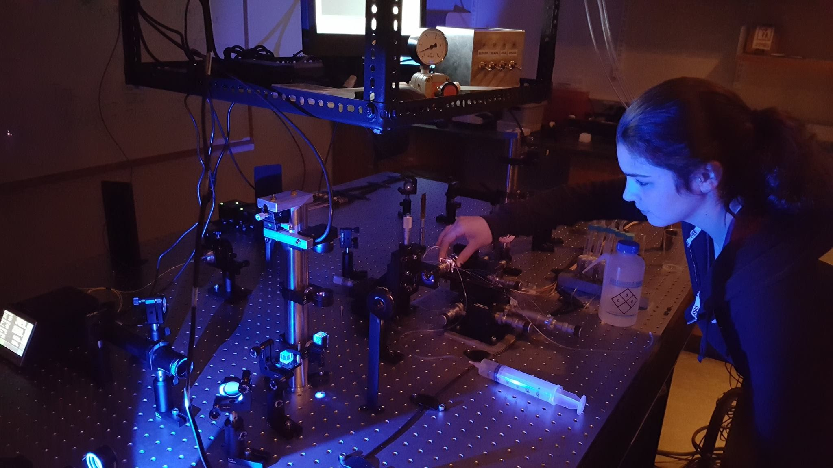
Participation in UR far less common in arts & humanities than in the sciences for many reasons
predominant definitions & models of research at odds with scholarly approaches of arts & humanities
less federal funding for non-STEM research

Slide 6
And, especially, epistemological differences between fields in which knowledge is created collaboratively and those in which discoveries come from individual insight

Slide 7
For epistemological reasons, scientific research benefits from collaboration
Multiple points of data collection & analysis
Corroborating experiments for validity
Varied needs for expertise at discrete stages (tasks differentiated for beginning or more advanced students)
Expectation of multiple authors
Tradition!

Slide 8
Arts & Humanities scholars have different ways of knowing & creating new knowledge
Favor individual insight & inspiration, developed after years of study
Do not necessarily aim for objectivity or replicable results but for uniqueness
Conduct “research” as background work for their “scholarship”

Slide 9
Arts & Humanities scholars have different ways of knowing & creating new knowledge
Sometimes need foreign language fluency or other specialized training to do scholarly work
Employ sophisticated theories/techniques often not taught until grad school

Slide 10
What makes High impact UR versus research paper in class?
Faculty mentoring component
Original (not necessarily publishable)
Looks like disciplinary scholarship
Disseminated

Slide 11
Three typical forms of UR
Students collaborating on faculty members’ scholarship
Students pursuing their own, mostly independent projects, mentored by a faculty member
Students conducting research or inquiry-based projects in the curriculum
Most common in sciences
Most common in arts & humanities
Most common in science labs & social science research methods courses
Toughest to scale this up!
Notes:
Get examples before showing
11

Slide 12
What are scalable models of students collaborating with faculty scholarship, including in the curriculum relevant to all disciplines including Arts and Humanities?

Slide 13
University of South Florida
Severan Database Project
Julie Langford (Roman historian) employed undergrads as collaborators in building databases of ancient coins
Based on knowledge from coursework and Julie’s mentoring, students entered coinage descriptions and images into the database
Students listed as researchers on the database http://web3.cas.usf.edu/main/other/severan/

Slide 14
Julie Langford made a list of skills her collaborators would ideally have:
Familiarity with the period (1st & 2nd-century Rome)
Ability to read limited Greek and Latin
Ability to read Italian, French, German, Spanish
Numismatic training
Experience interpreting early Christian iconography
Computer coding skills

Slide 15
And figured out where and how students could learn what they needed for the project:
Familiarity with the period (1st & 2nd-century Rome)
Ability to read limited Greek and Latin
Ability to read Italian, French, German, Spanish
Numismatic training
Experience interpreting early Christian iconography
Computer coding skills
Julie’s course content
Key terms in course content & ”cheat sheets”
Key terms taught to student researchers
Seminar course & tutoring
Art History courses
Recruited students with skills

Slide 16
Practices to put in place
Teach your research
Evaluate students on skills as well as content
Identify and teach the sort of skills needed to analyze your data
Model your methodologies for your students in class
(Langford)

Slide 17
Structuring the process of collaboration with students
How can you break down your research into smaller, more digestible components?
What checks could you build into the process to ensure that the student contributions are of high quality?
How can assisting with your research help the student?
(Langford)

Slide 18
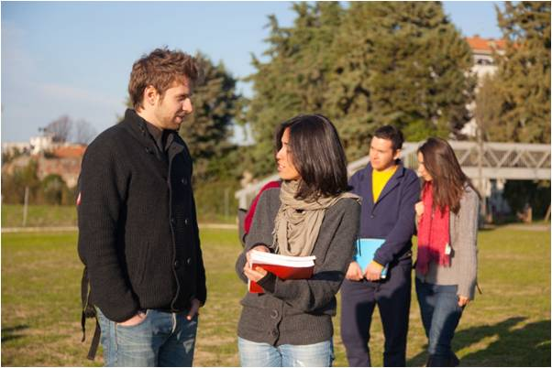
Bridgewater State University Lisa Rafferty’s Verbatim Theatre project in THEA 299
Director & playwright Lisa Rafferty (Boston Theatre Co.) collaborated with students to write “verbatim” (documentary) play about Boston Marathon bombings
Finish Line is based on 100 interviews of people connected in some way to the tragedy

Slide 19
Lisa scaffolded the needed skills as part of the course content
Students first learned to take oral histories on safe topic of sports fandom
Used smartphone apps to record interviews; borrowed transcription software to transcribe and edit
Created verbatim play on the “sports fan” interviews
Then each student conducted one of the interviews for Finish Line
Students acknowledged in the program & publication of the play

Slide 20
What about Models used at Austin College?
Please share…

Slide 21
Using “Backward Design” and Curriculum Content to Design New Models for Undergraduate Research

Slide 22
1. What is the ultimate goal and/or intended product of the scholarly project?
2. List or mind-map the big questions, problems, and unknowns you can already identify.
3. Break down those questions, problems, and unknowns into research tasks, especially those that students might be able to explore.
4. Based on those tasks, what are the knowledge bases, competencies, and skills students need for the project?
5. Beginning at the end, sketch out a scaffold of research skills for your students. You have an idea about your major aims for the project. How about the goals for your students?
6. Where and how could each of those goals be introduced and developed in the course? (How could students be introduced to each skill? What’s the next step for developing the skill further?)

Slide 23
Just the start of a conversation…
Wolfgang Lueckel
Lisha Story
Tom Blake
Creative Inquiry in the Arts and Humanities Institute
November 2017
Lincoln University (PA)

Slide 24
Work Cited
Final Thoughts or ideas?
Langford, Julie. “Models of Undergraduate Research in the
Humanities: The Severan Database Project.” Creative Inquiry in the Arts & Humanities: Models of Undergraduate Research. Naomi Yavneh Klos, Jenny Olin Shanahan, and Greg Young (Eds.) Washington, DC: Council on Undergraduate Research Press, 2011. 49-58.

