Slide 1
Data from recent surveys of Austin College students and alumni: What does it mean and how can we use it?
Johnson Center Presentation
Dr. Karla McCain

Slide 2
Outline
SACS update
NSSE
HEDS alumni

Slide 3
SACS Timeline
Year 3 of assessment data collection: 2017/18
September 2018: Compliance certification for reaffirmation of accreditation is due which includes 3 cycles of assessment data
About November 2018: receive report from off-site committee
About January/February 2019: response to report from off-site committee due
On-site visit by SACS Reaffirmation Committee (peer review): April 2-4, 2019
Official vote on reaffirmation: December 2019

Slide 4
NSSE
National Survey of Student Engagement
Allows for benchmarking relative to other institutions, ex. Our Carnegie Class: Baccalaureate Colleges: Arts & Sciences Focus
Given in spring 2017 to first year students and seniors

Slide 5
NSSE Engagement Indicators

Slide 6
Trends from individual questions
First year students answered more similarly to Carnegie class peers than seniors did
Much more likely to be higher than Carnegie class peers than be lower than them
Most questions with significantly lower scores are related to writing
First-year | Below peers | Above peers
Effect size < 0.3 | 3 | 7
Effect size > 0.3 | 1 | 5
Senior | Below peers | Above peers
Effect size < 0.3 | 4 | 19
Effect size > 0.3 | 1 | 7

Slide 7
High Impact Practices
Participated in one HIP Participated in two or more HIPS

Slide 8
Specific High Impact Practices

Slide 9
Topical Module: Inclusiveness and Engagement with Diversity
Much bigger differences between us and peers for seniors than for first-year students
Series of items about if institution provides a supportive environment for various kinds of diversity
Series of items about if the institution emphasizes various ways to build community and combat discrimination
Not significantly different from peers on questions related to learning about these topics

Slide 10
Topical Module: First-year Experiences and Senior Transitions
Almost no difference between AC and peers for first-year experience items
Slightly more likely to use peers for help with coursework
Somewhat more differences between AC and peers for senior items
Slightly more likely to think their major prepared them for post-graduation plans and more likely to intend to work in related field
More confidence in technological skills

Slide 11
Free Response for Senior Transitions
"Is there anything your institution could have done better to prepare you for your career or further education? Please describe. "
% of comments | Nature of comments
26% | Nothing; AC was awesome
15% | Not responsive to question
40% | Better connection between academics and career options
11% | Grumpy pre-med students
9% | More opportunities to develop financial literacy

Slide 12
HEDS Alumni Survey
Higher Education Data Sharing Consortium
Allows for benchmarking relative to other institutions in HEDS that took the survey
Generally speaking, smallish liberal arts colleges
Given in spring 2014 to all alumni
70% of sample 10 years or longer after graduation
30 % of sample less than 10 years since graduation

Slide 13
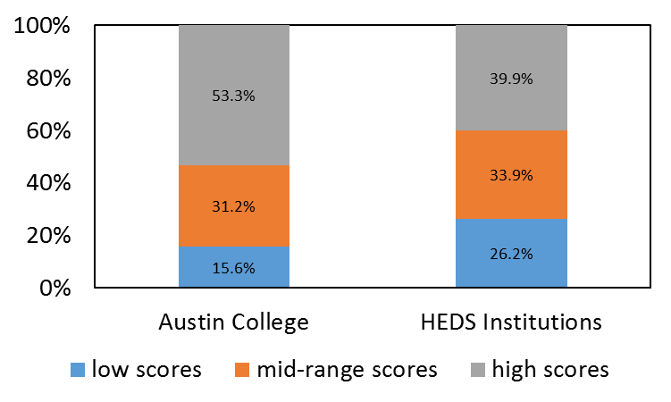
Good Teaching and High-Quality Interactions with Faculty

Slide 14
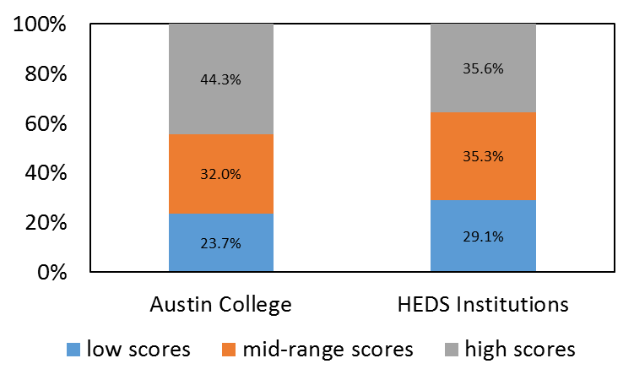
Challenging Assignments and High Faculty Expectations

Slide 15
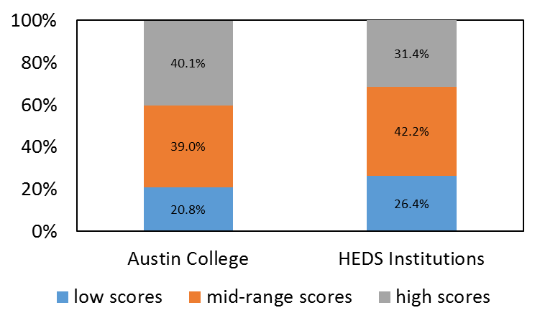
Interactions with Diversity

Slide 16
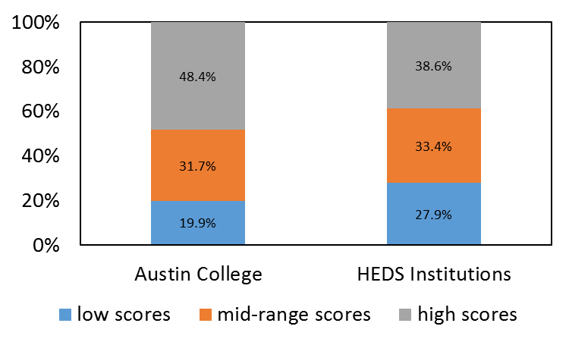
Development of Social and Civic Engagement

Slide 17
To what extent did your experience with each of the following as an undergraduate contribute to your learning and personal development?
Engagement Activity | quite a bit + very much | % participated
Study Abroad | 87% | 68%
Sorority/Fraternity | 79% | 49%
Internships | 72% | 58%
Independent Study | 67% | 65%
On Campus Employment | 64% | 63%
Athletics | 62% | 34%
Service Organizations | 58% | 79%
Working with Faculty on Research | 58% | 45%
Community Service | 54% | 89%
Performing Arts/Music | 52% | 49%
Off-Campus Employment | 49% | 52%
Religious Groups | 49% | 47%
Multicultural Student Groups | 48% | 55%
Student Government | 46% | 41%
Intermural or Club Sports | 44% | 55%
Political Organizations/Clubs | 43% | 48%
Student Publications | 28% | 38%

