Slide 1
The Sherman Museum
By Caitlin Nagy

Slide 2
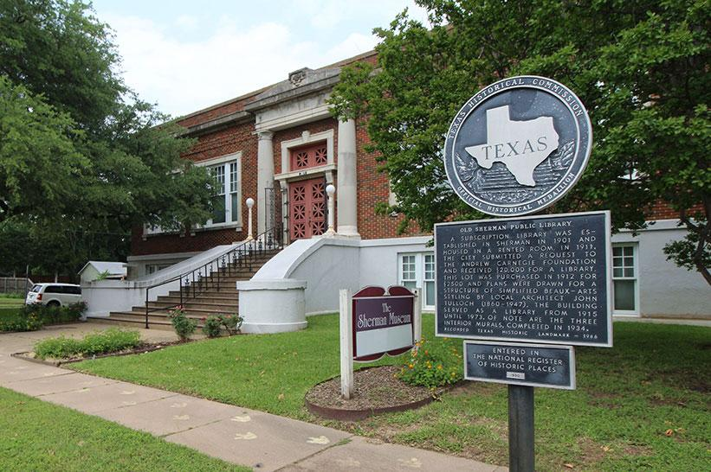
The Museum
The History
Built in 1914 as a Carnegie Library
Museum started in 1976
The Church of Christ holds over 50,000 artifacts

Slide 3
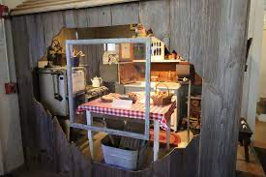
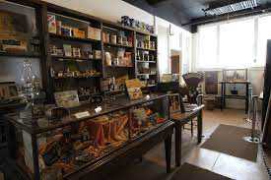
Exhibits
Farm and Ranch Room
The General Store
Native American Artifacts
The exhibits housed in the Sherman Museum are a mix of permanent and featured rooms. I had the opportunity this summer to create the newest exhibition “Consumer Products through the Years” which will be talked about later on.

Slide 4
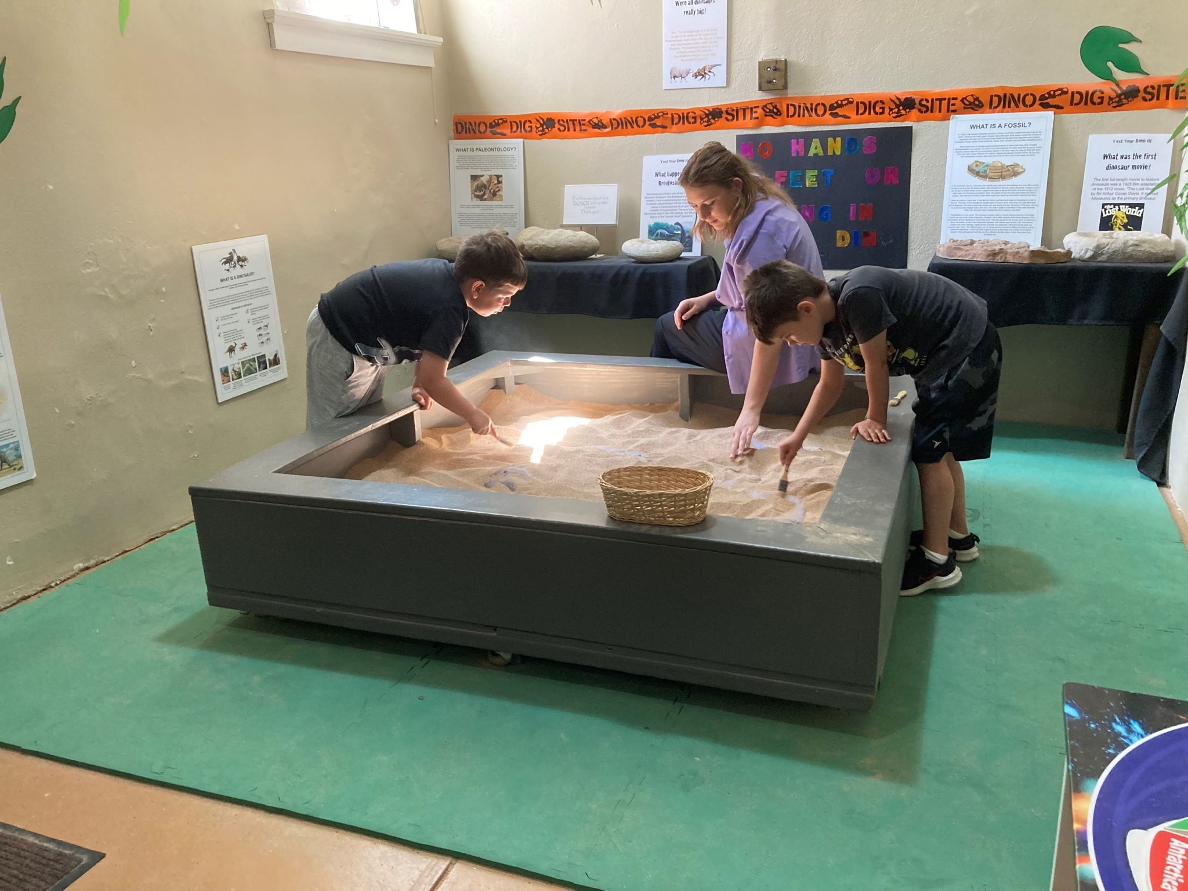
Dino Days
Dinosaurs and Meteorites
Create Dino Day crafts and schedule for the Kids
Create packets to take home

Slide 5
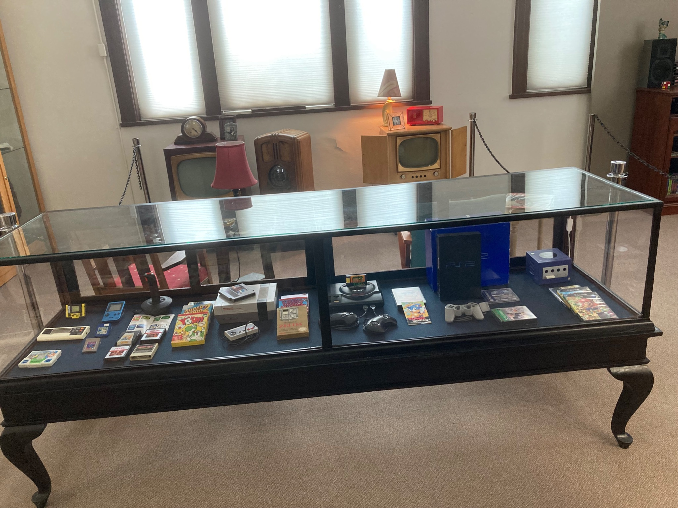
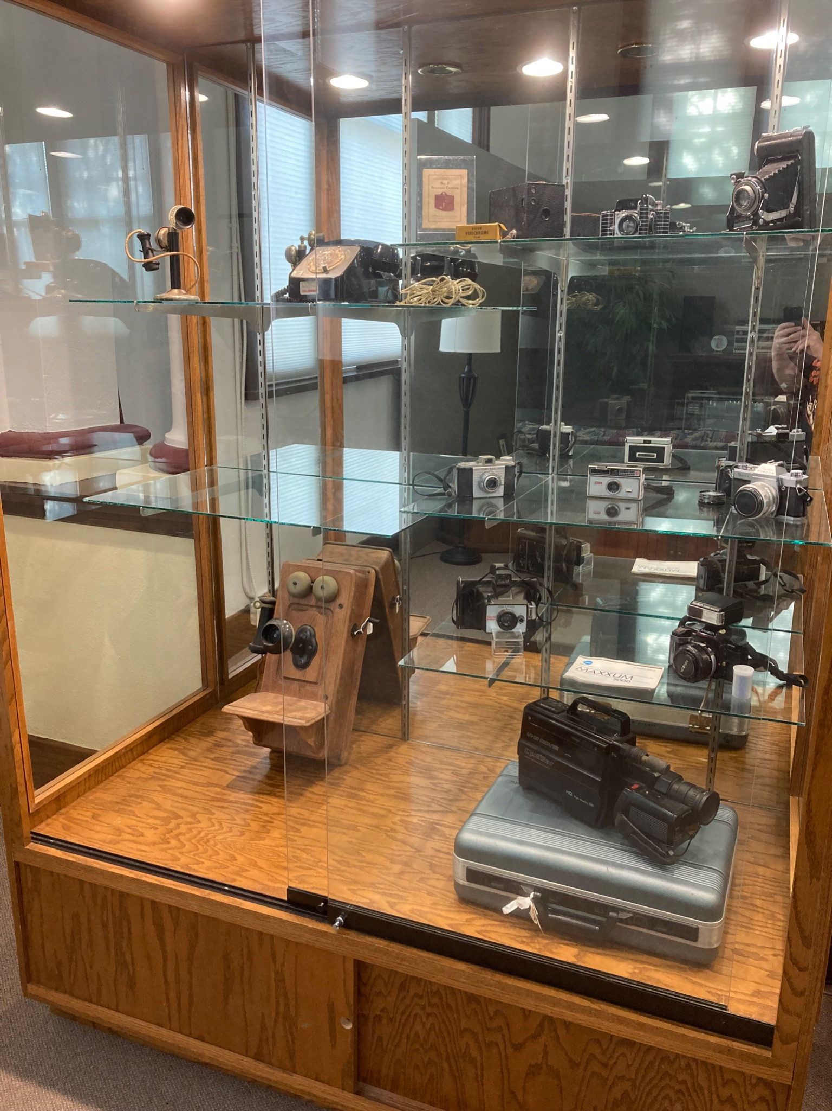
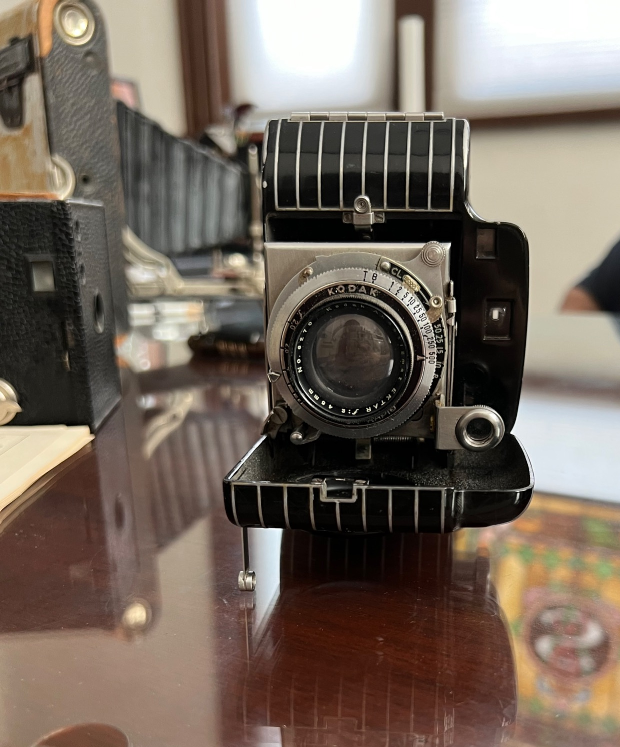
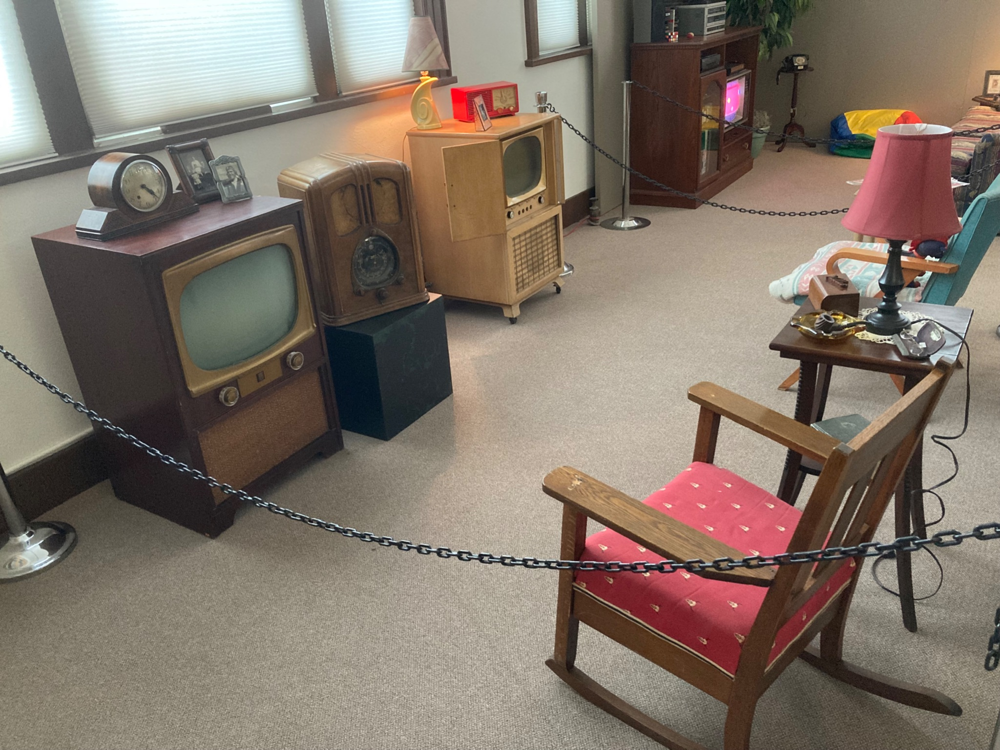
Newest Exhibition
Consumer Products through the Years
Newest Exhibition
Drew out the Layout
Helped research Artifacts
Film Cameras
Jacob made sure to involve me in every step
Touch of class antique mall

Slide 6
My experience
I really enjoyed the work environment
Helped me understand I’d like to further my studies
More hands on at a local Museum

Slide 7
Thank you!
I am truly thankful for this experience and a special thank you Stuart Holcombe and Jacob Lee

