Slide 1
Sam Rayburn Library and Museum
2023 CSMS Internship - Trey Salyer

Slide 2
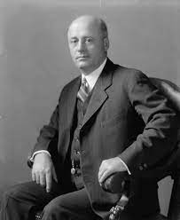
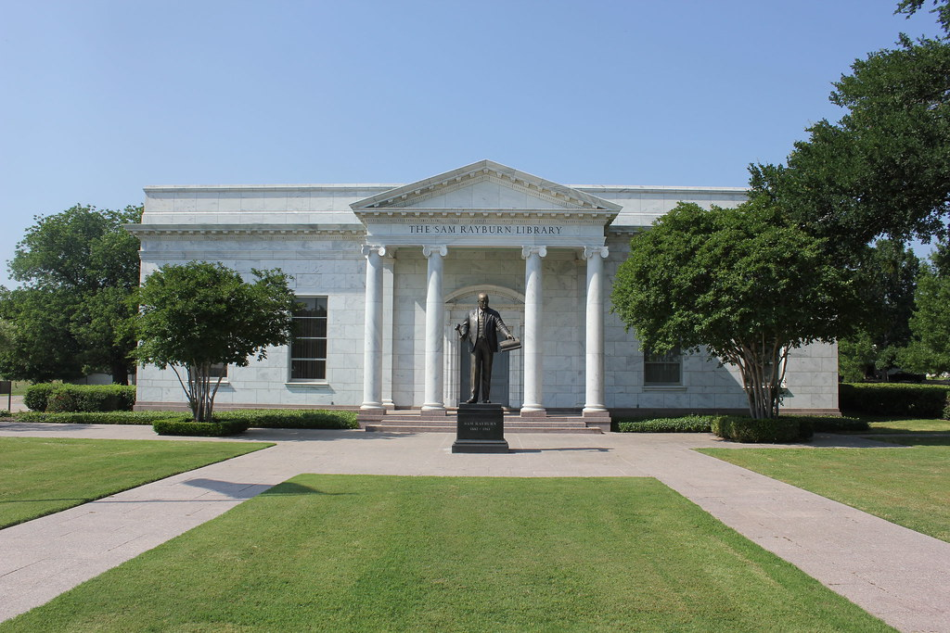
The Library
The library was constructed in 1957 and acted as a library and research center for congressman Sam Rayburn, who holds the record for the longest serving Speaker of the House of Representatives in our nation’s history.
The Rayburn family moved from Tennessee to Bonham, Texas when Sam was a young child.
The library not only has Sam’s personal books, but many items he owned (such as gifts he received), and congressional records during and before his governmental political career.

Slide 3
My Tasks at the Library
Completed inventory of the museum’s artifact collection, assessed current condition and updated information in the database as needed.
Completed inventory of library collection, identifying damaged books and assessing damage based on predetermined matrix.
Completed inventory of archival materials from the Sam Rayburn papers stored at the museum.
Designed an exhibit for the “Gifts of a Nation” display case.
Assisted in creating a new collection of separated and recently donated materials pertaining to the U.S.S. Sam Rayburn submarine.
Assisted in the installation of the museum’s quilt display for the 2023 Bonham Quilt Hop and participated as a docent during the quilt event.

Slide 4
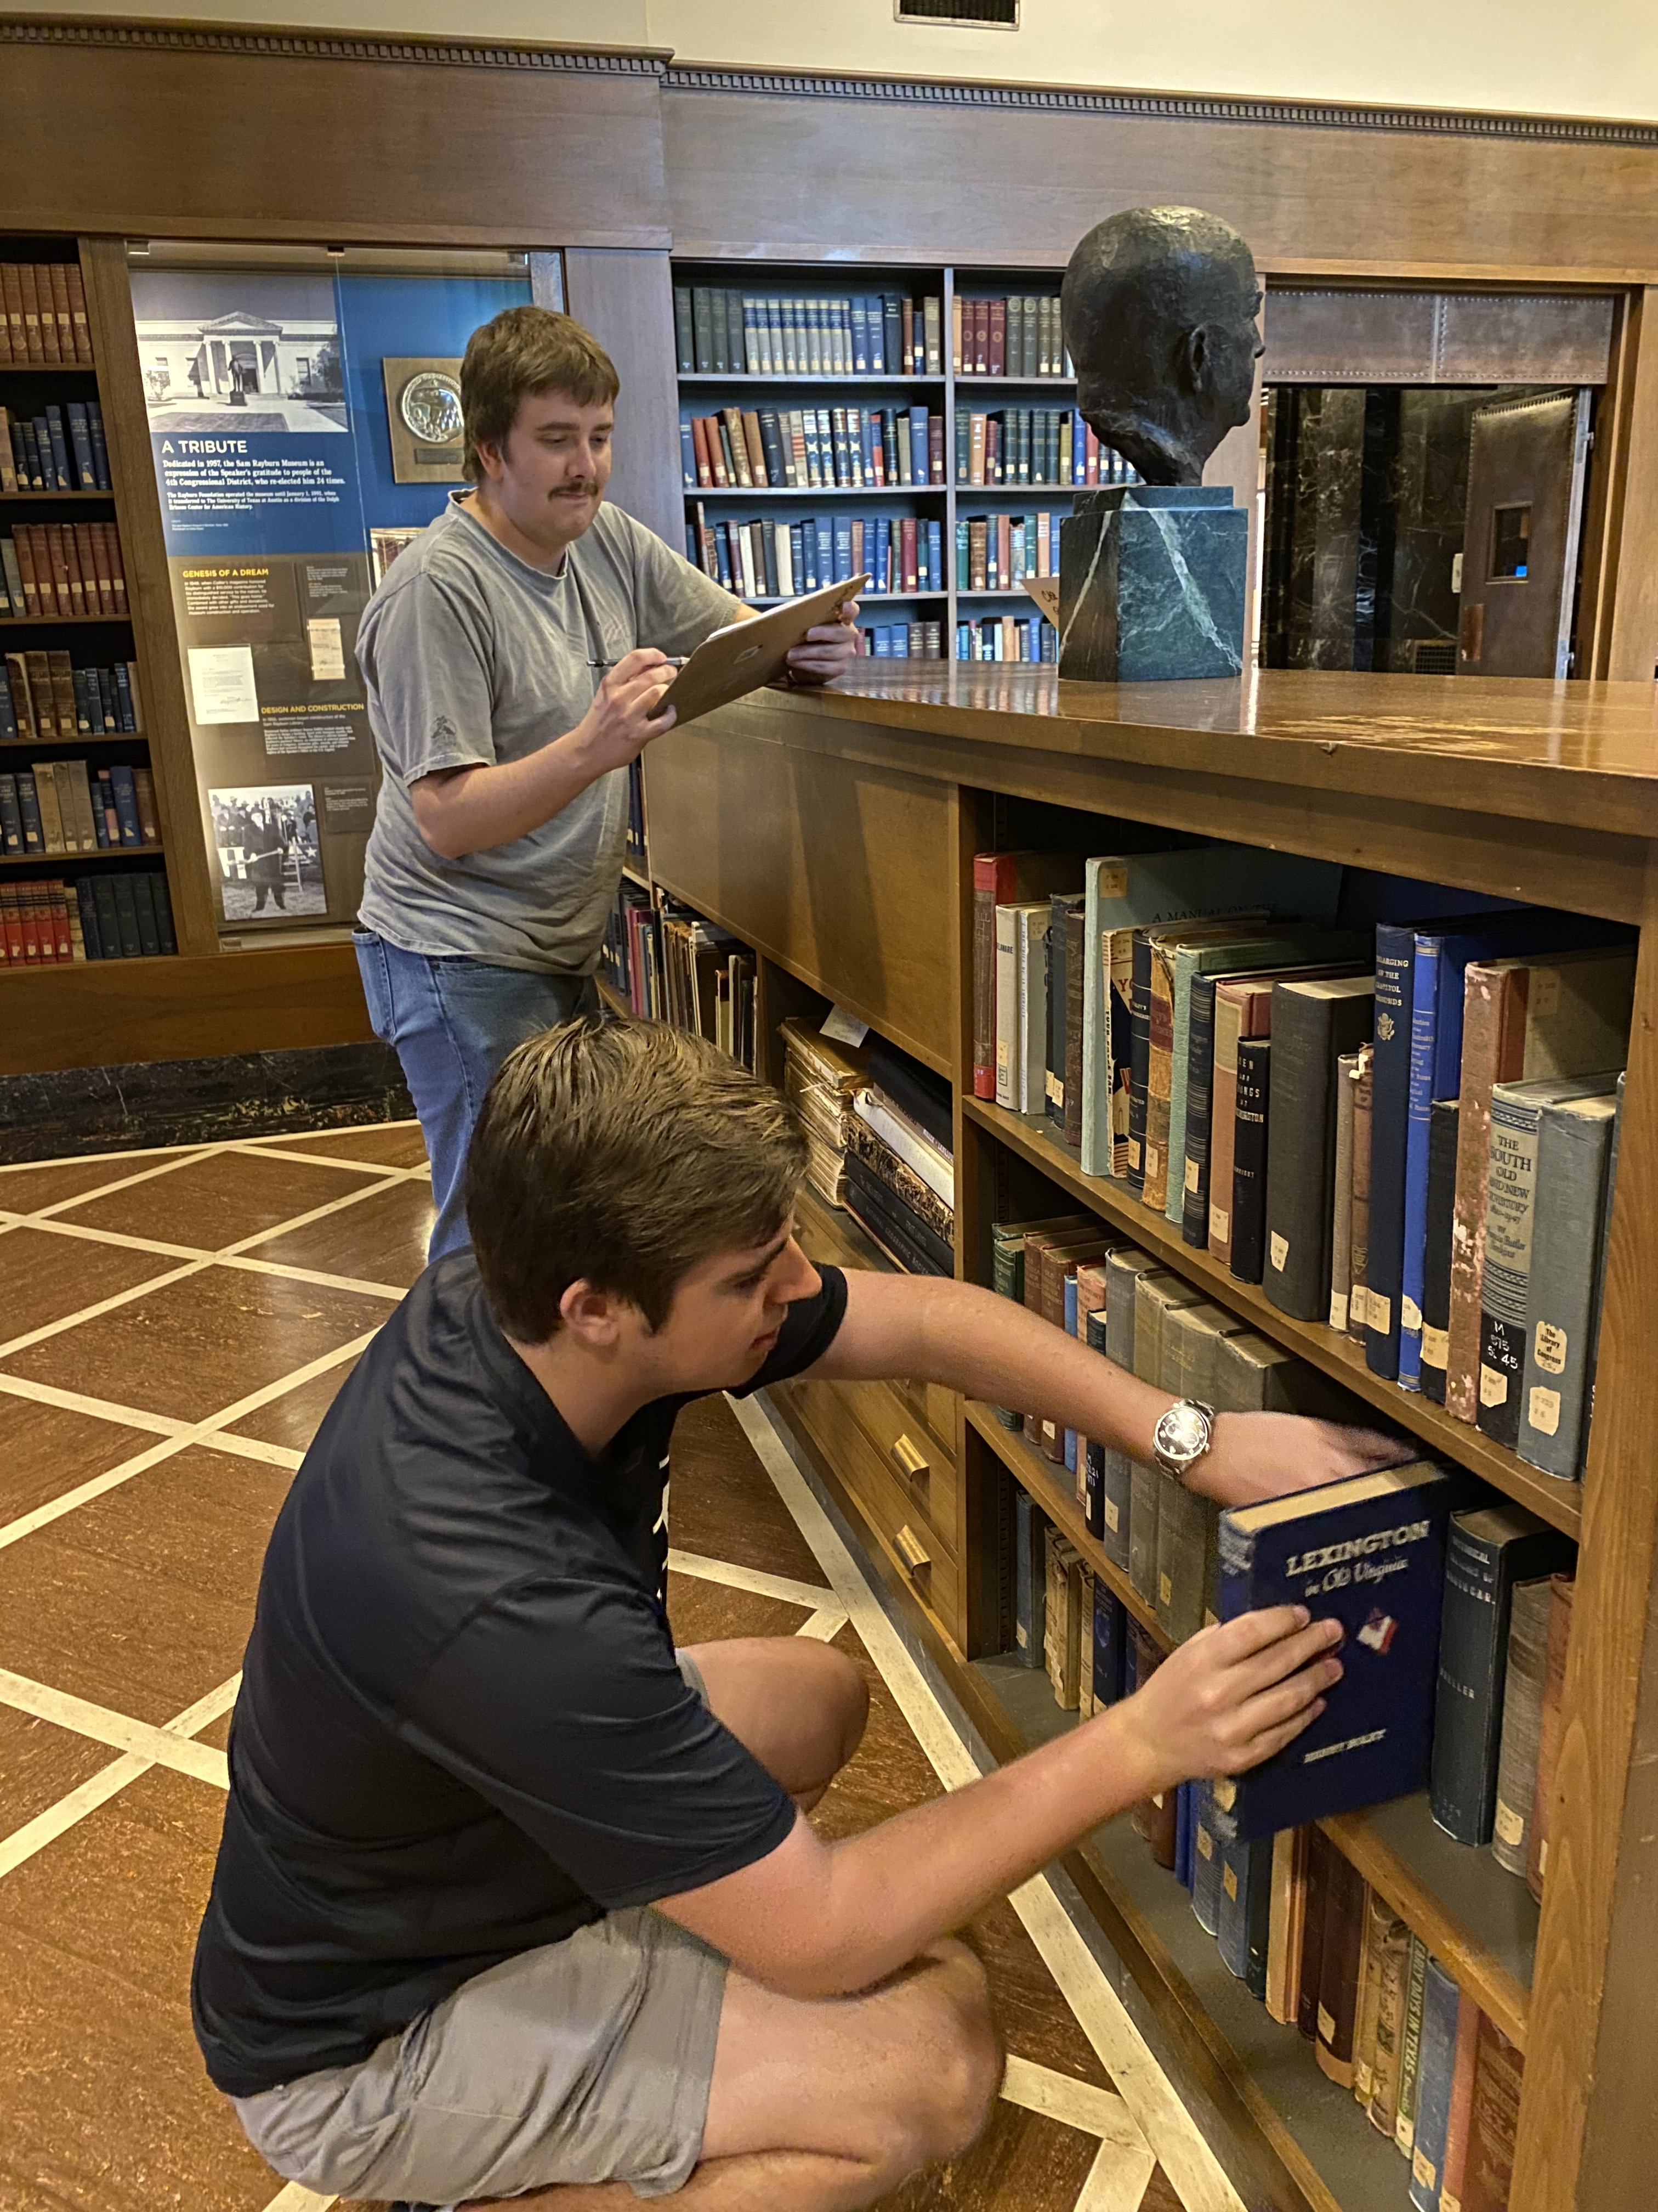
Inventory
The Library’s collection of artifacts, books, and archival materials had to be examined, and updated if needed.
All items were arranged based on the Congressional Library database system- Items are displayed according to appearance of low individual numerical digits, not necessarily in numerical order.
e.g.: A book labeled T-1501 may appear right after T-149 but before T-151 due to the zero that immediately follows the 5 in 1501
Not only did I overcome the tricky database organization, but I teamed up with a Sam Rayburn Library docent to help complete book inventory.

Slide 5
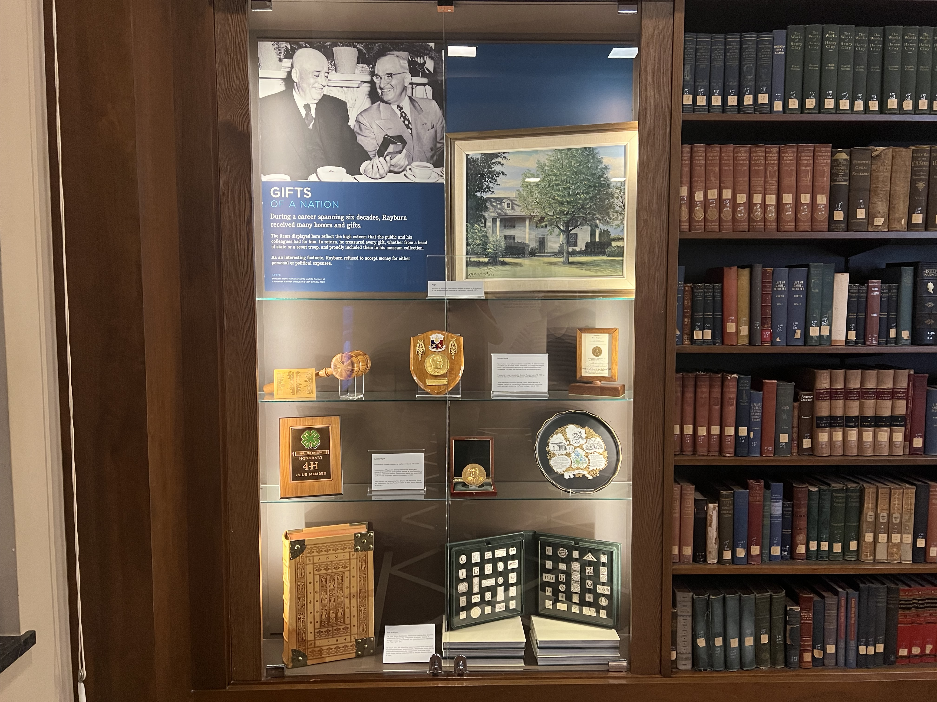
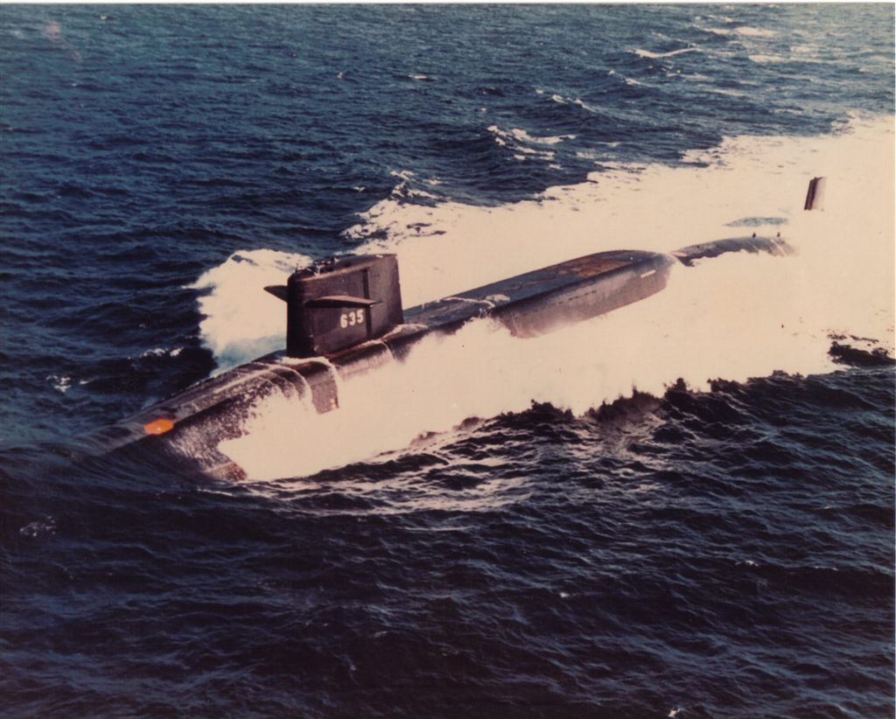
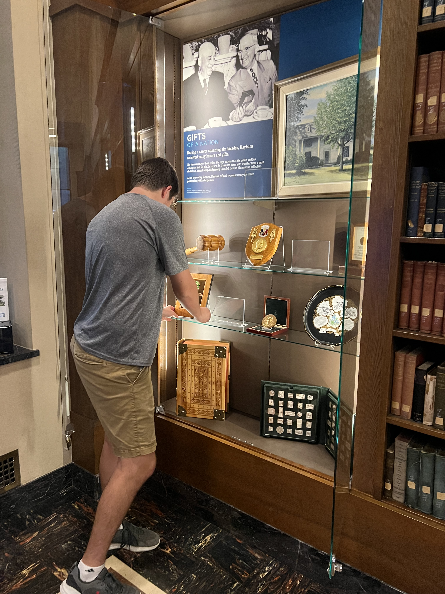
Exhibition Assistance
I designed a temporary exhibit named “Gifts of a Nation”, which highlights the diverse range of gifts Sam Rayburn received from groups, organizations, and individuals across the world.
I helped create a new exhibit which covers the U.S.S. Sam Rayburn submarine which was named after Mr. Rayburn and highlights submarine-related artifacts that were donated by members of the community to the Library.

Slide 6
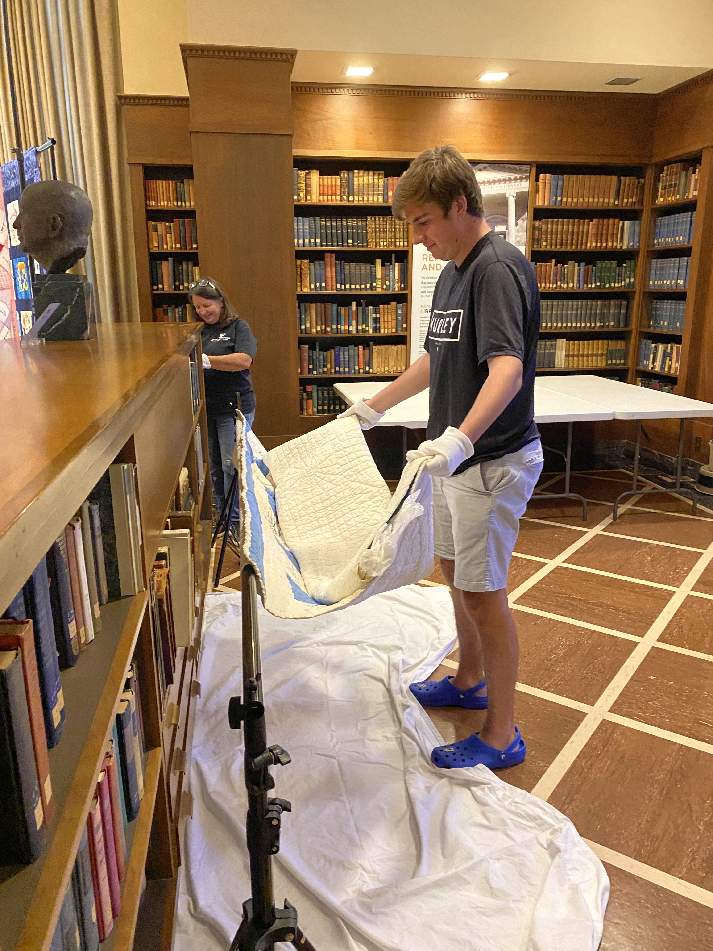
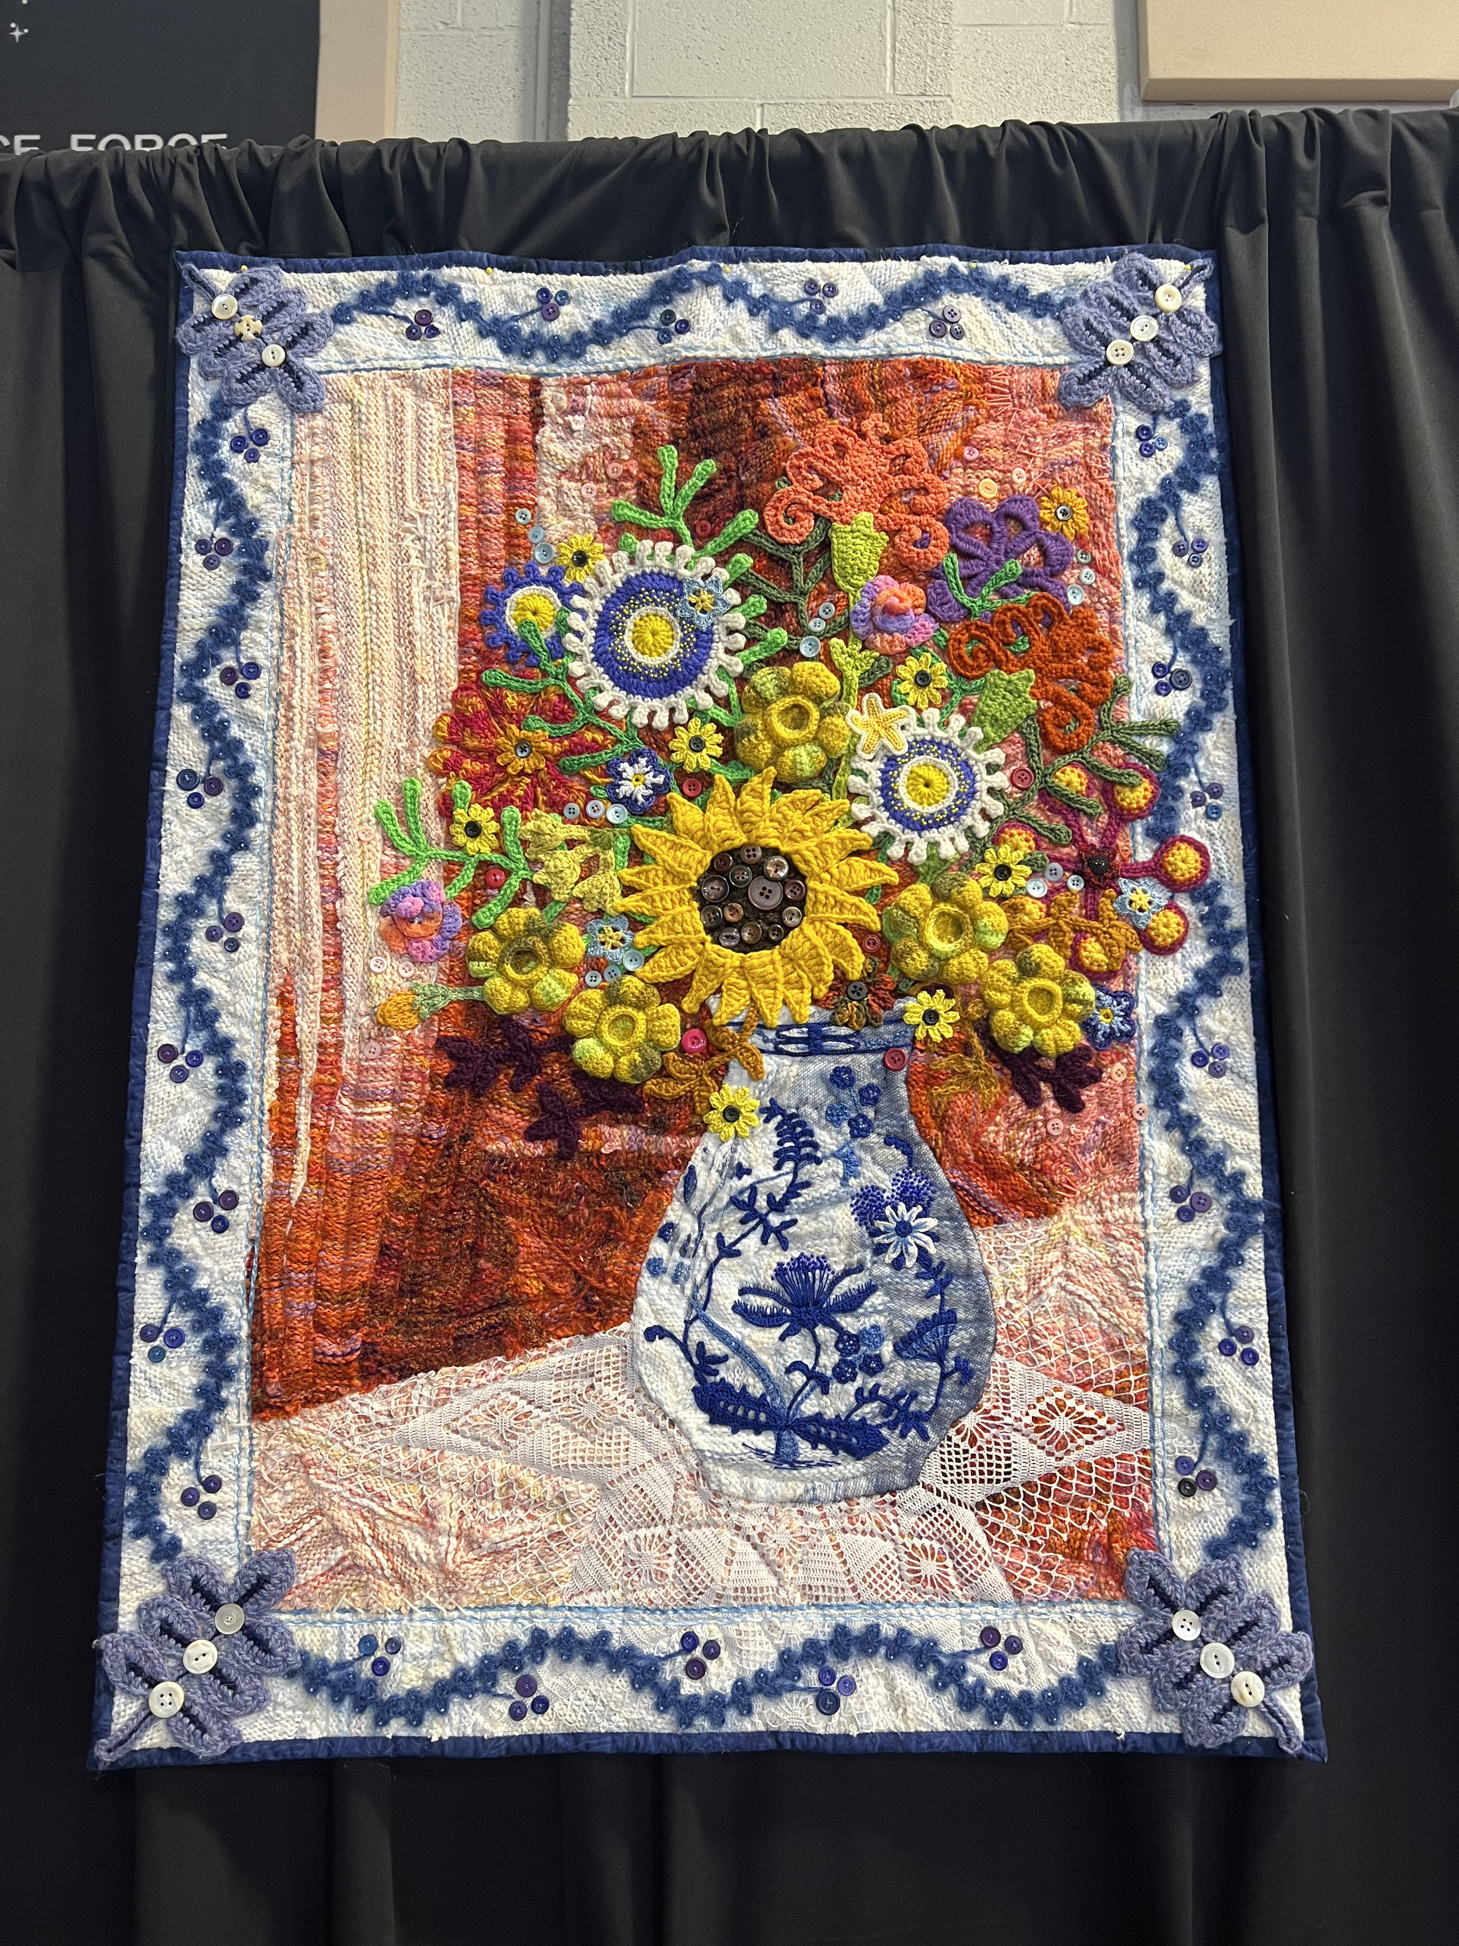
Quilt Hop
Quilt Hop is an annual Bonham festival that displays quilts created from all over the Texoma area ranging from a few years old to over a hundred years old.
I assisted in preparing the quilt display presented at the Sam Rayburn Library and Museum location for this festival.
There were fantastic quilts displayed at many locations around town.

Slide 7
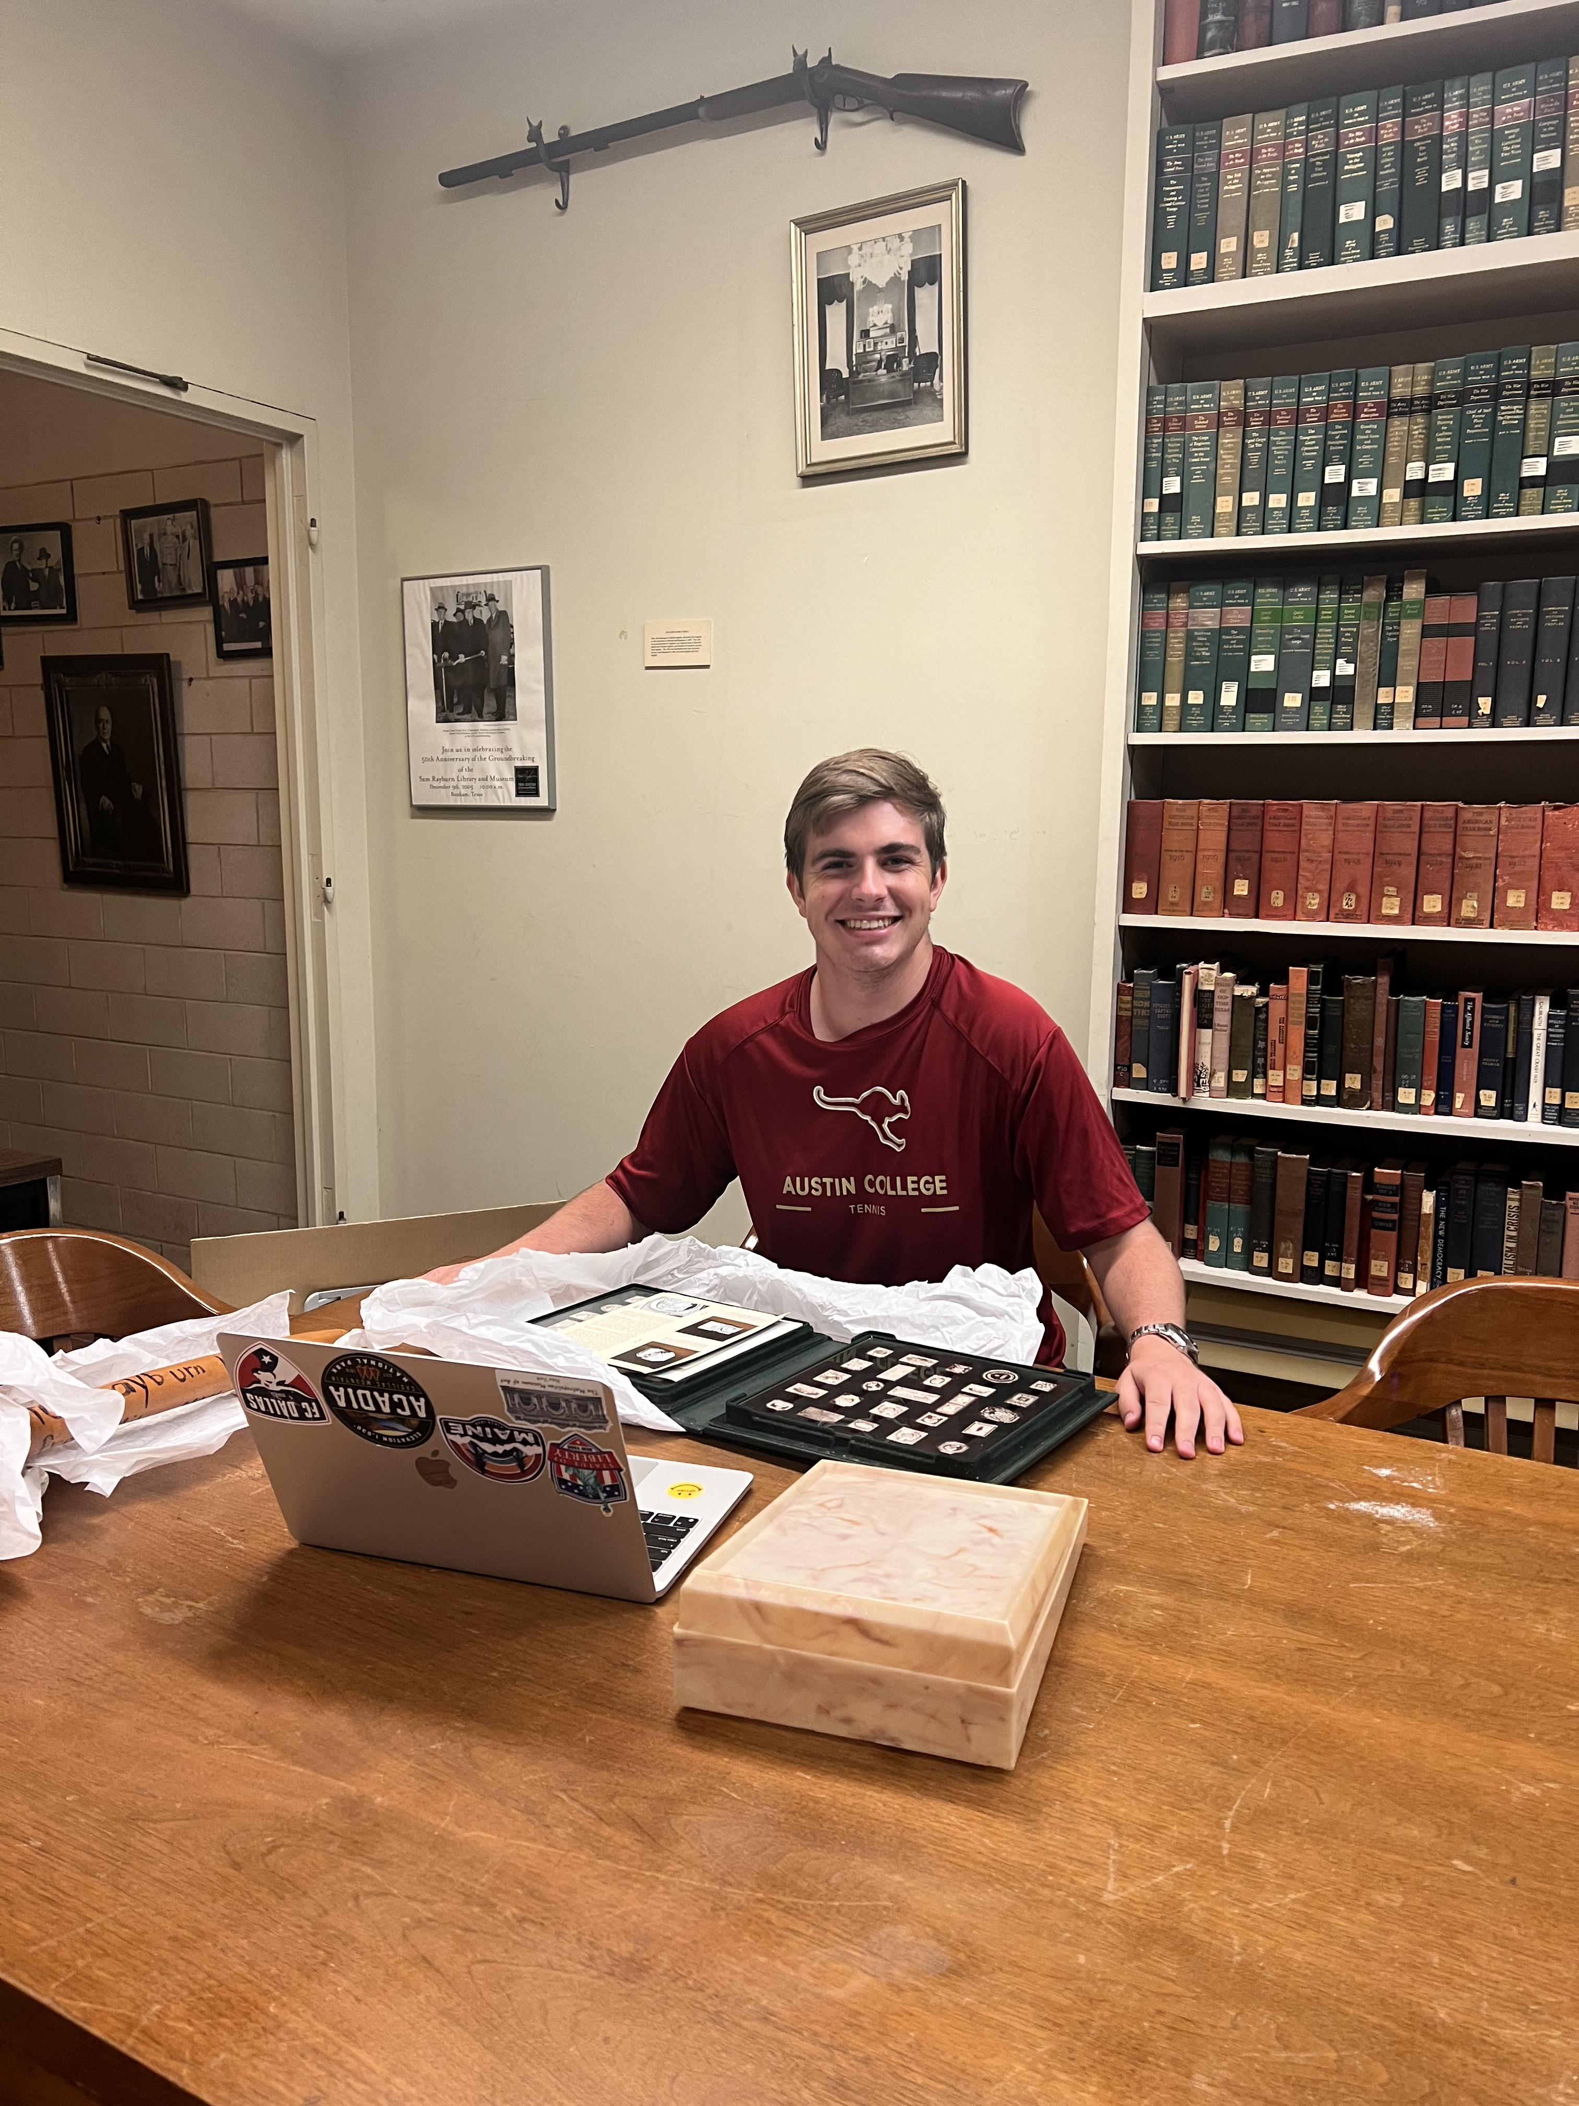
Overall Takeaways
My Summer CSMS internship at the Sam Rayburn Library and Museum gave me a lot of experience related to what I want to pursue as a career.
Although archival work isn’t exactly what I plan to do as a career, my internship gave me valuable experience and lessons on:
Understanding and managing digital and physical archival systems
The basics of utilizing archival sources to present and synthesize information
Working hands-on with historical primary and secondary artifacts and sources
Assessing damage and quality of items
Time management on various lengthy projects
Teamwork and staying determined when faced with new and confusing information
Basics of serving as a museum docent
This experience will greatly help me in pursuing a career in academia as a historical researcher since this path will involve handling artifacts, sorting through digital and physical archives and databases for relevant information, and collaborating with others to achieve a goal.

Slide 8
Special Thanks
Thank you to CSMS Director Professor Julie Hempel and CSMS Coordinator Wendy Wilson for giving me the opportunity to intern through the Austin College CSMS program.
Thank you to Emma Trent, my supervisor at the Sam Rayburn Library and Museum, who permitted me to intern at the library and helped me learn an abundant amount about the archival and museum management field.
And finally, thank you to Kim and Andrew, whom I worked alongside with during my time as an intern at the Library.

